Slide 1
Bank Loan Case Study Report
By Yash Shinde
Jupyter Notebook:- Click Here to Download
Video Presentation:- Click Here to Watch Video Presentation

Slide 2
Project Description!
In this data analytics project, as a data analyst at a finance company specializing in urban loans, my goal is to tackle the challenge of loan default among customers with limited credit history. Through Exploratory Data Analysis (EDA), I will explore the dataset to identify missing data and apply appropriate methods to handle it effectively. My comprehensive EDA will play an important role in enhancing lending decisions and reducing default risks for the company.

Slide 3
Table of Contents
2
1
3
4
Analysis
Introduction
Project description and Tech Stack Used
A. Managing Missing Data
B. Detecting Data Outliers
C. Analyze Data Imbalance
D. Univariate, Segmented Univariate, and Bivariate Analysis
E. Top Correlations for Different Scenarios
Insights
Conclusion
Summarize the insights and knowledge gained during the project.
Described what I have achieved through the project

Slide 4
"Unveiling insights through data analysis to enhance lending decisions and mitigate loan default risks."

Slide 5
-> Jupyter Notebook -> PowerPoint -> Github -> Google Drive
Tech Stack Used :-

Slide 6
Importing and Exploring Dataset

Slide 7
Importing and Exploring Dataset
First, I created a new notebook and imported libraries and dataset.
application_data = pd.read_csv("application_data.csv")
Then I explored the dataset using the following programs.
To see the five rows from top and bottom I used head() and tail() respectively.
application_data.head()
application_data.tail()
Then by Using the column function see the names of all the columns/variables.
application_data.columns
Then by using the shape function observe the shape of the DataSet.
application_data.shape
By using the describe function obtained all descriptive stats for the numeric variables in the DataSet.
application_data.describe()
Same Operations are performed on the previous_application dataset.

Slide 8
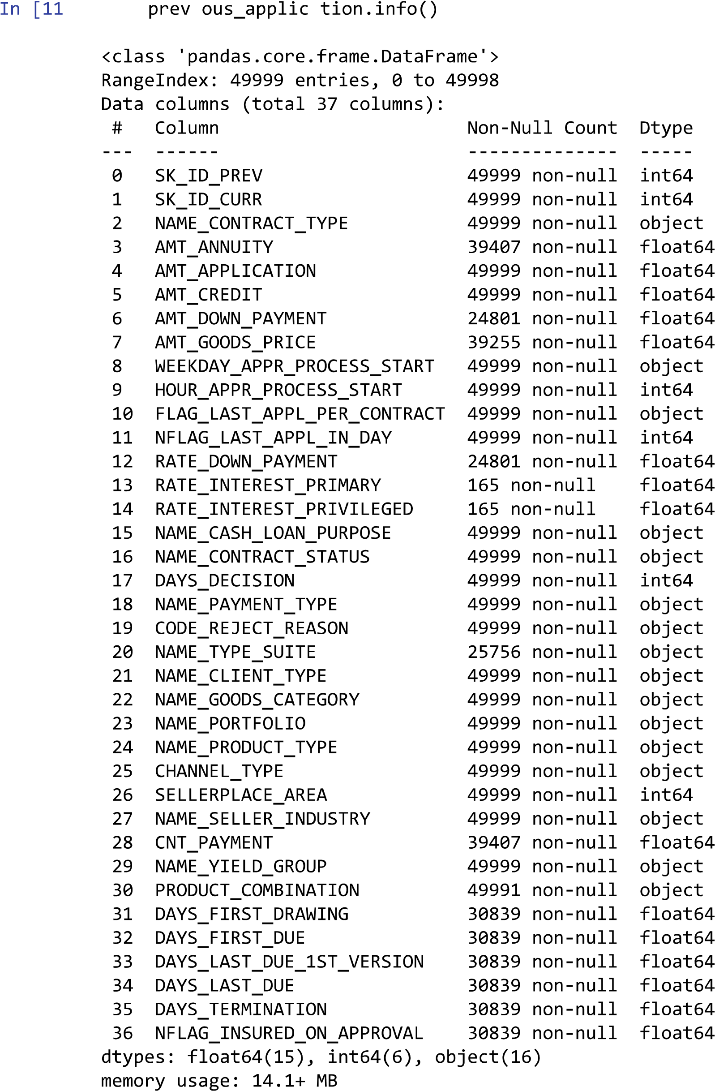
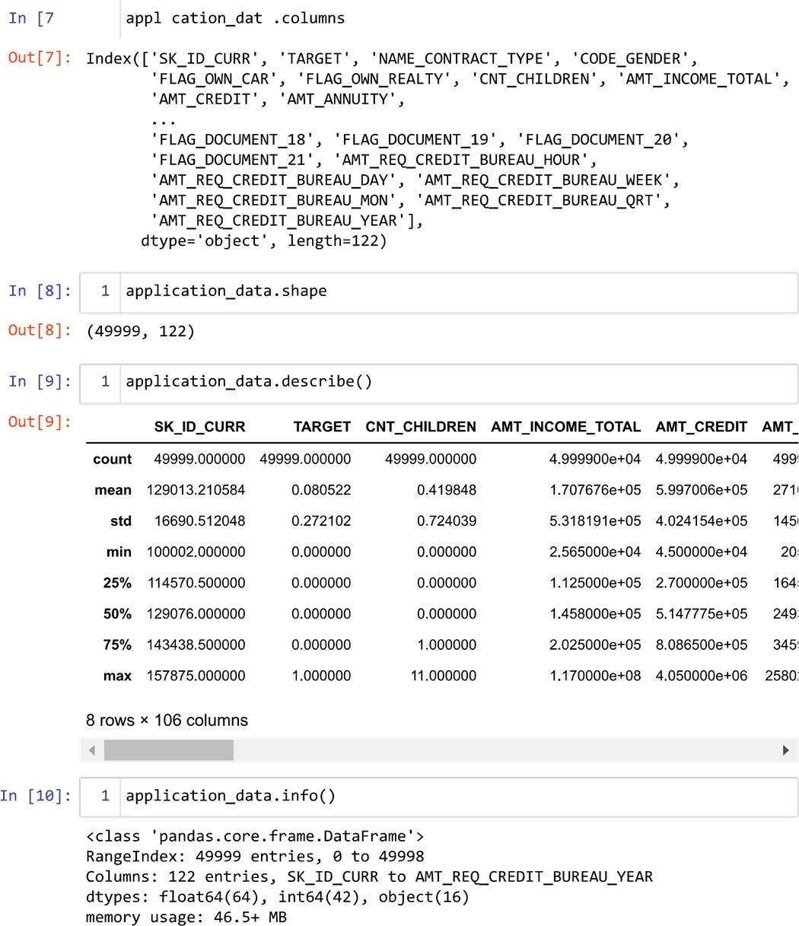


Slide 9
A
Managing Missing Data
Identify Missing Data and Deal with it Appropriately

Slide 10
Managing Missing Data
First, I calculated the blank cells/Null values in the dataset.
a = application_data.isnull().sum()
Then I Created a bar chart to visualize the proportion of missing values for each variable.
Then I used following code/program to find the columns/variables having more than 50% missing values.
a = a[a>(len(application_data)*0.5)]
We don't need this information for our analysis thus removing those columns using the drop function.
application_data = application_data.drop(columns=a.index)
Then I performed observation on remaining values and replaced the remaining null values with appropriate values using the following code.
filldict = dict(zip(keys, values))
application_data.fillna(value=filldict, inplace=True)application_data.tail()
Then by Using the duplicated function remove the duplicate rows from the dataset.
application_data.duplicated().sum()
Some variables have negative values converted those value into posivtive using the abs() function for better analysis.
application_data[['DAYS_BIRTH' ,'DAYS_EMPLOYED' ,'DAYS_REGISTRATION' ,'DAYS_ID_PUBLISH']] = application_data[['DAYS_BIRTH' ,'DAYS_EMPLOYED' ,'DAYS_REGISTRATION' ,'DAYS_ID_PUBLISH']].abs()
In this way I Identified Missing values and Handled them.

Slide 11
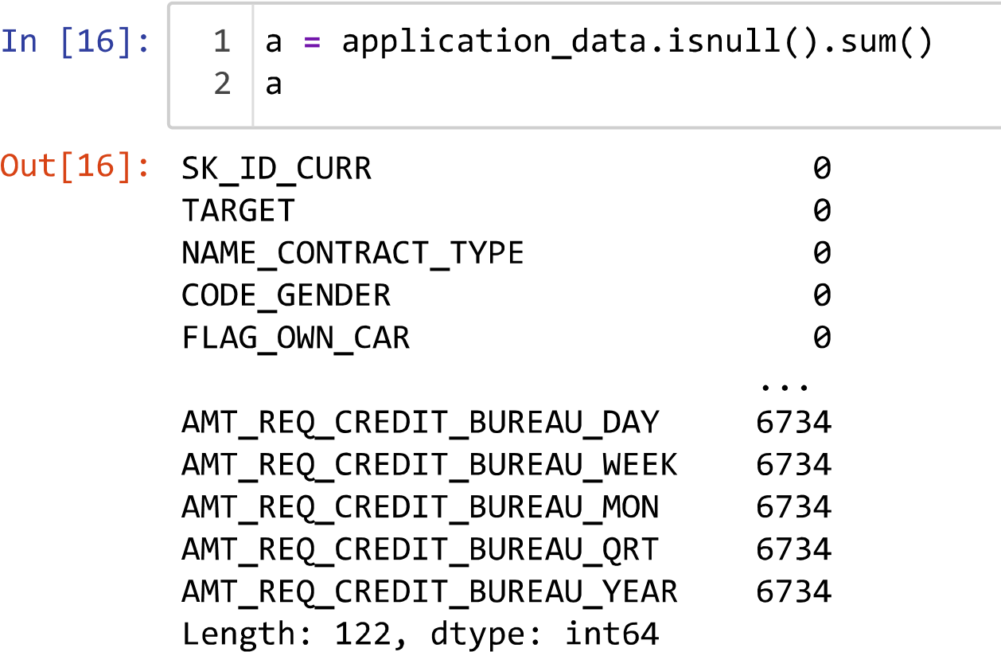
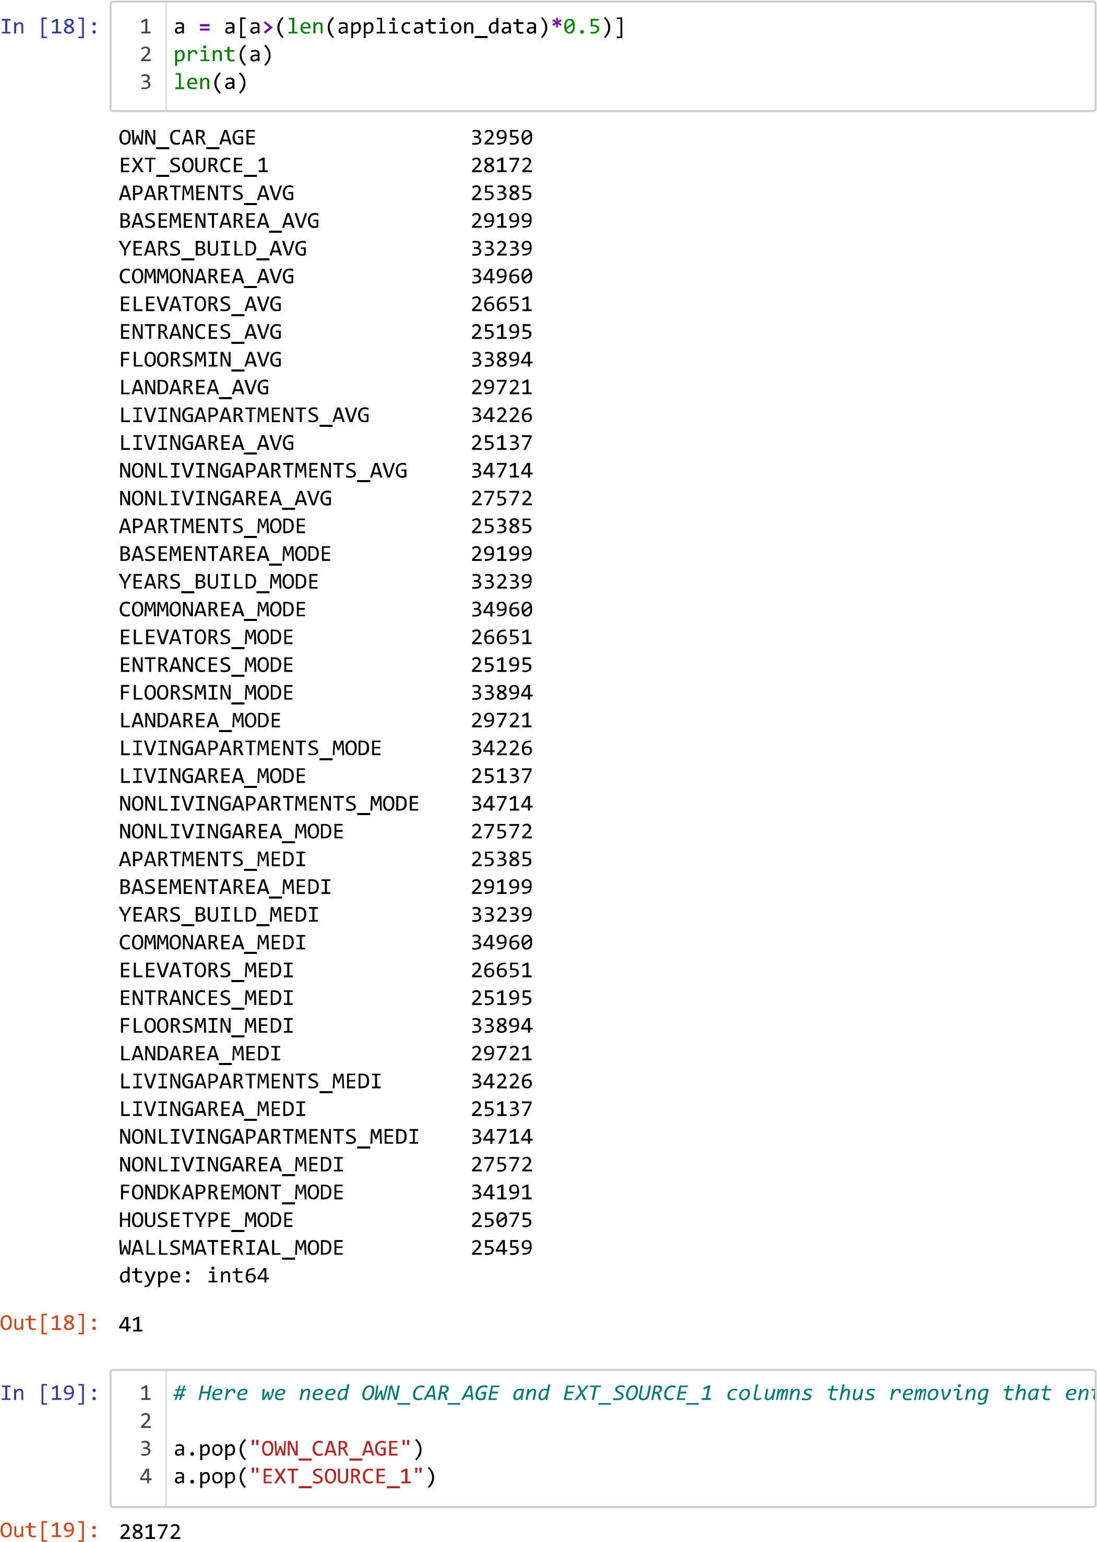
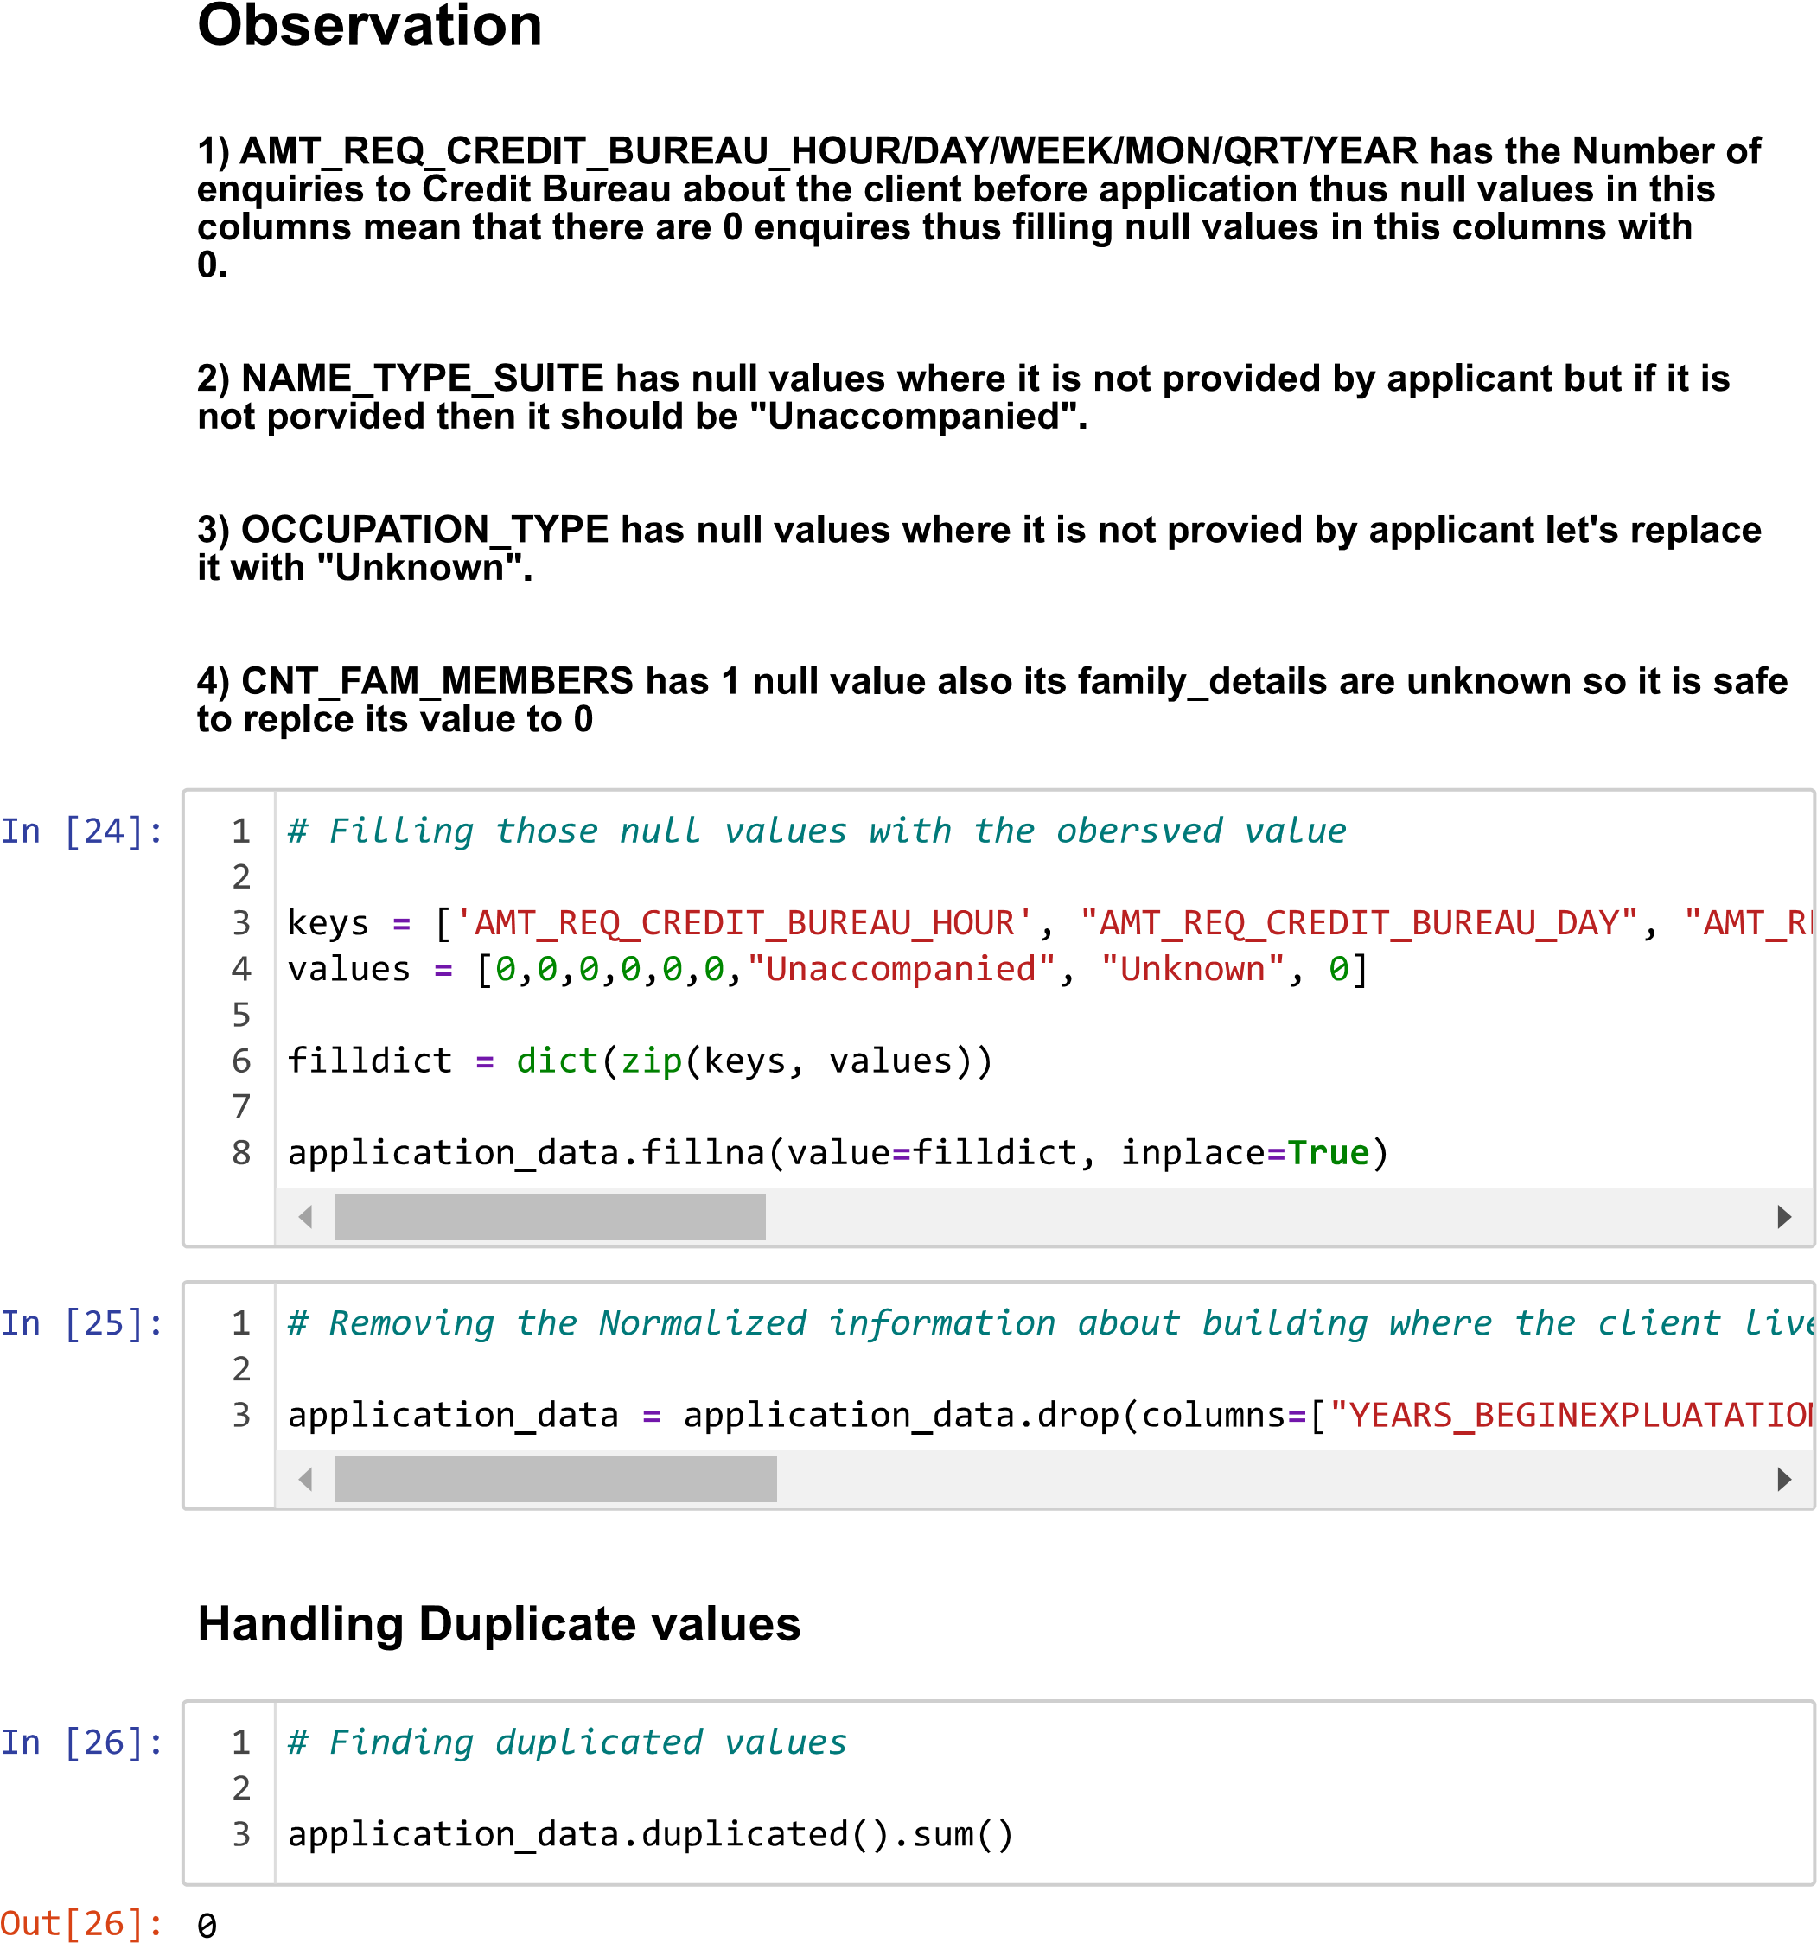

Slide 12
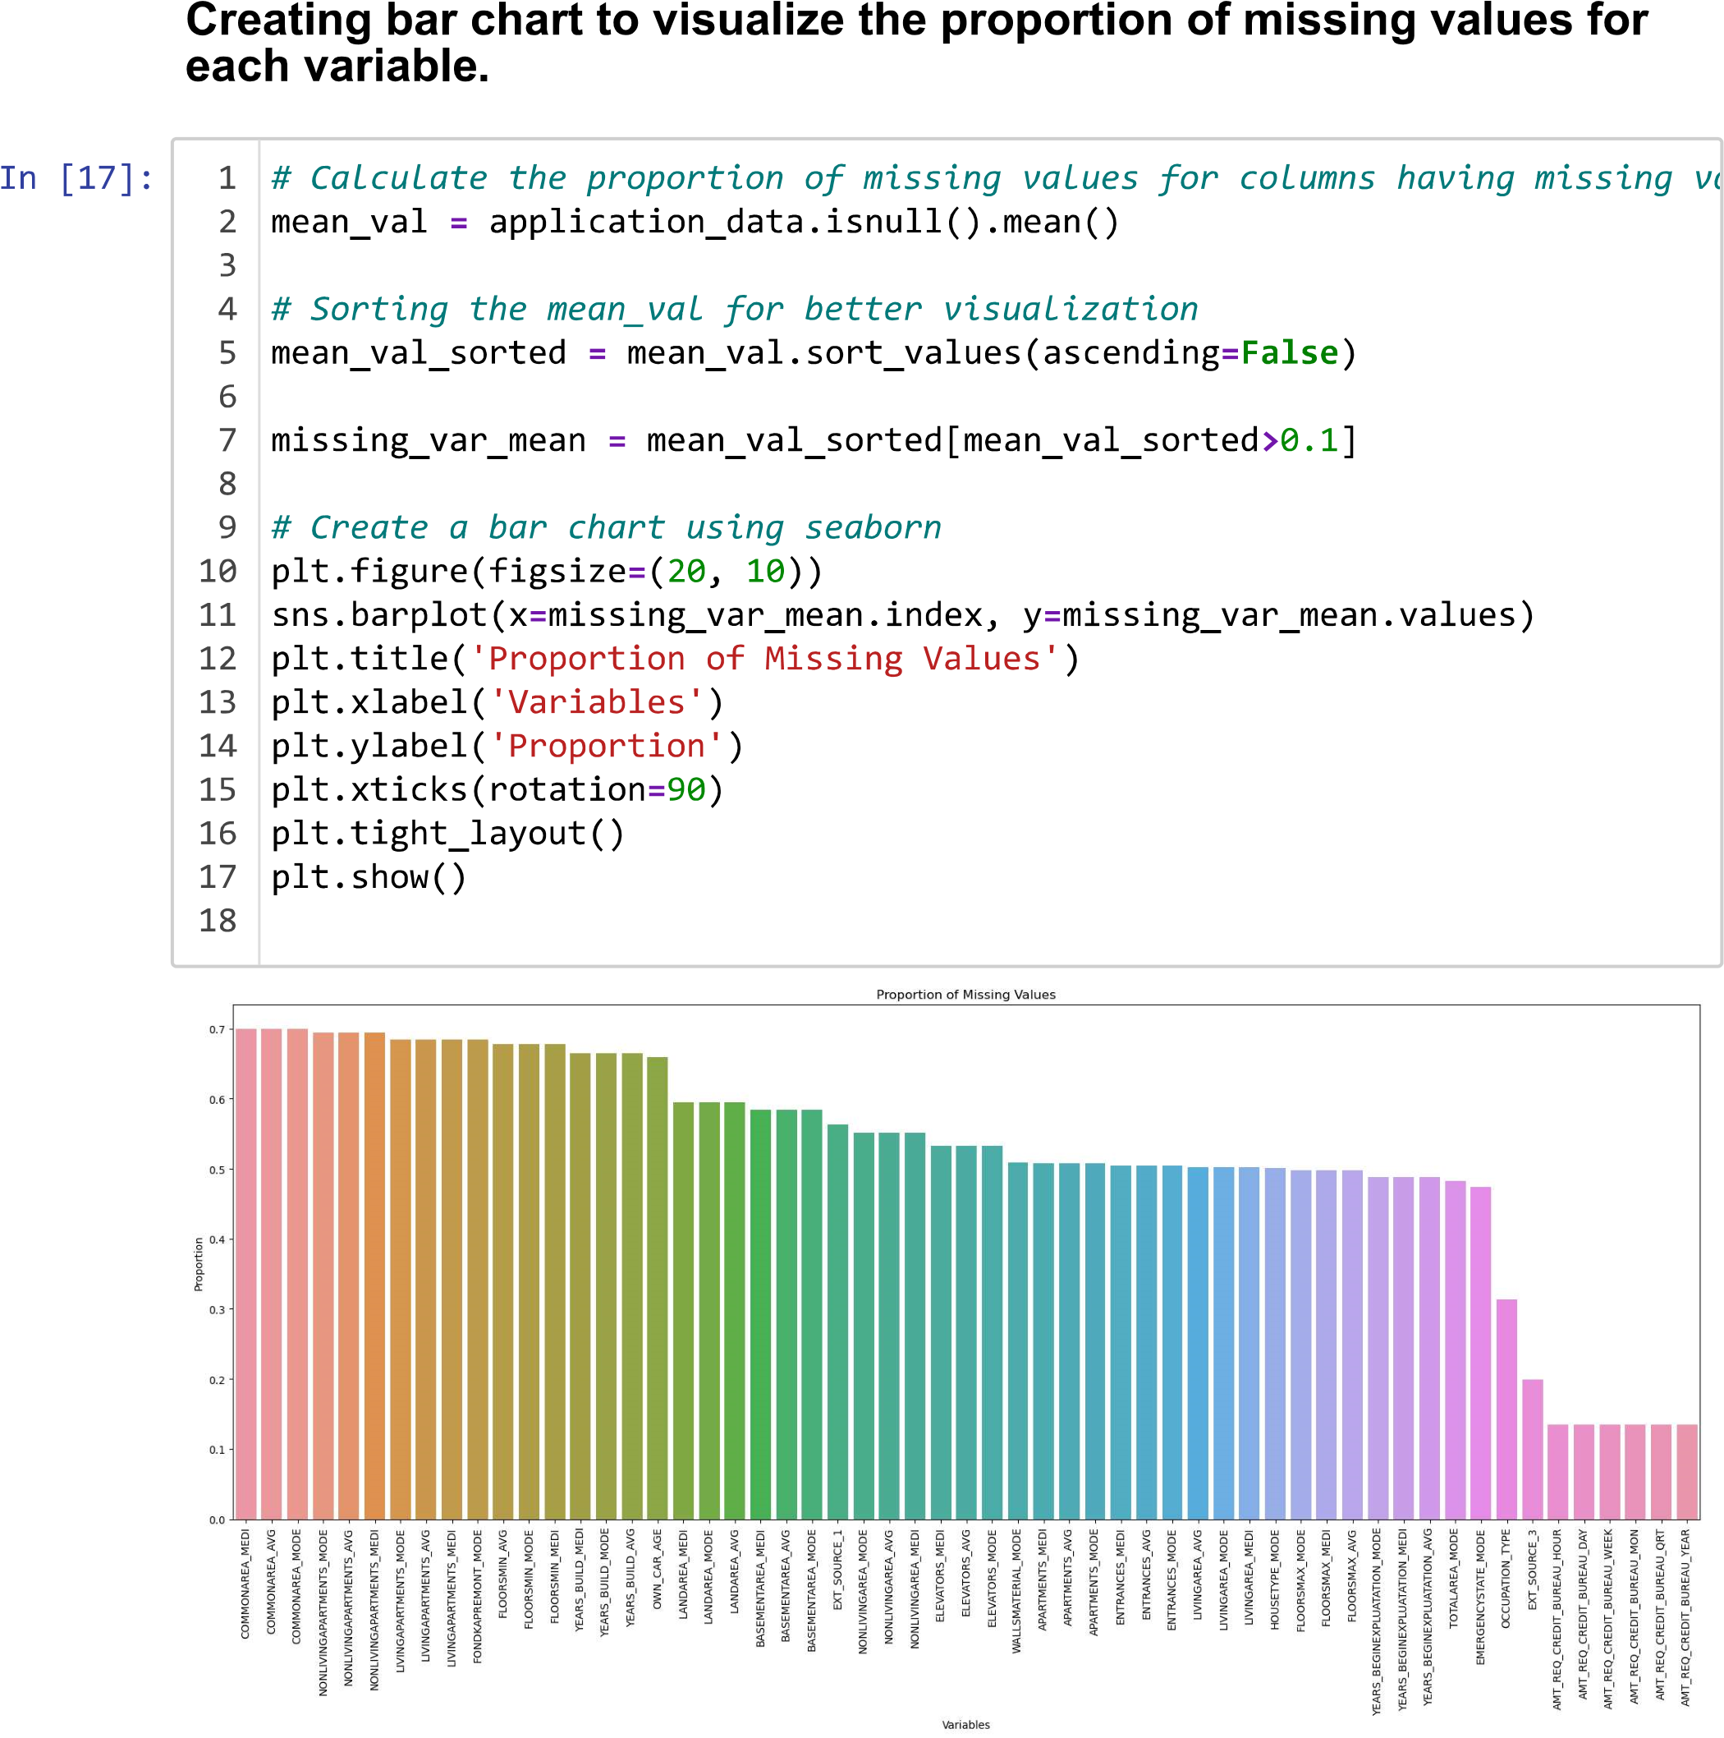

Slide 13
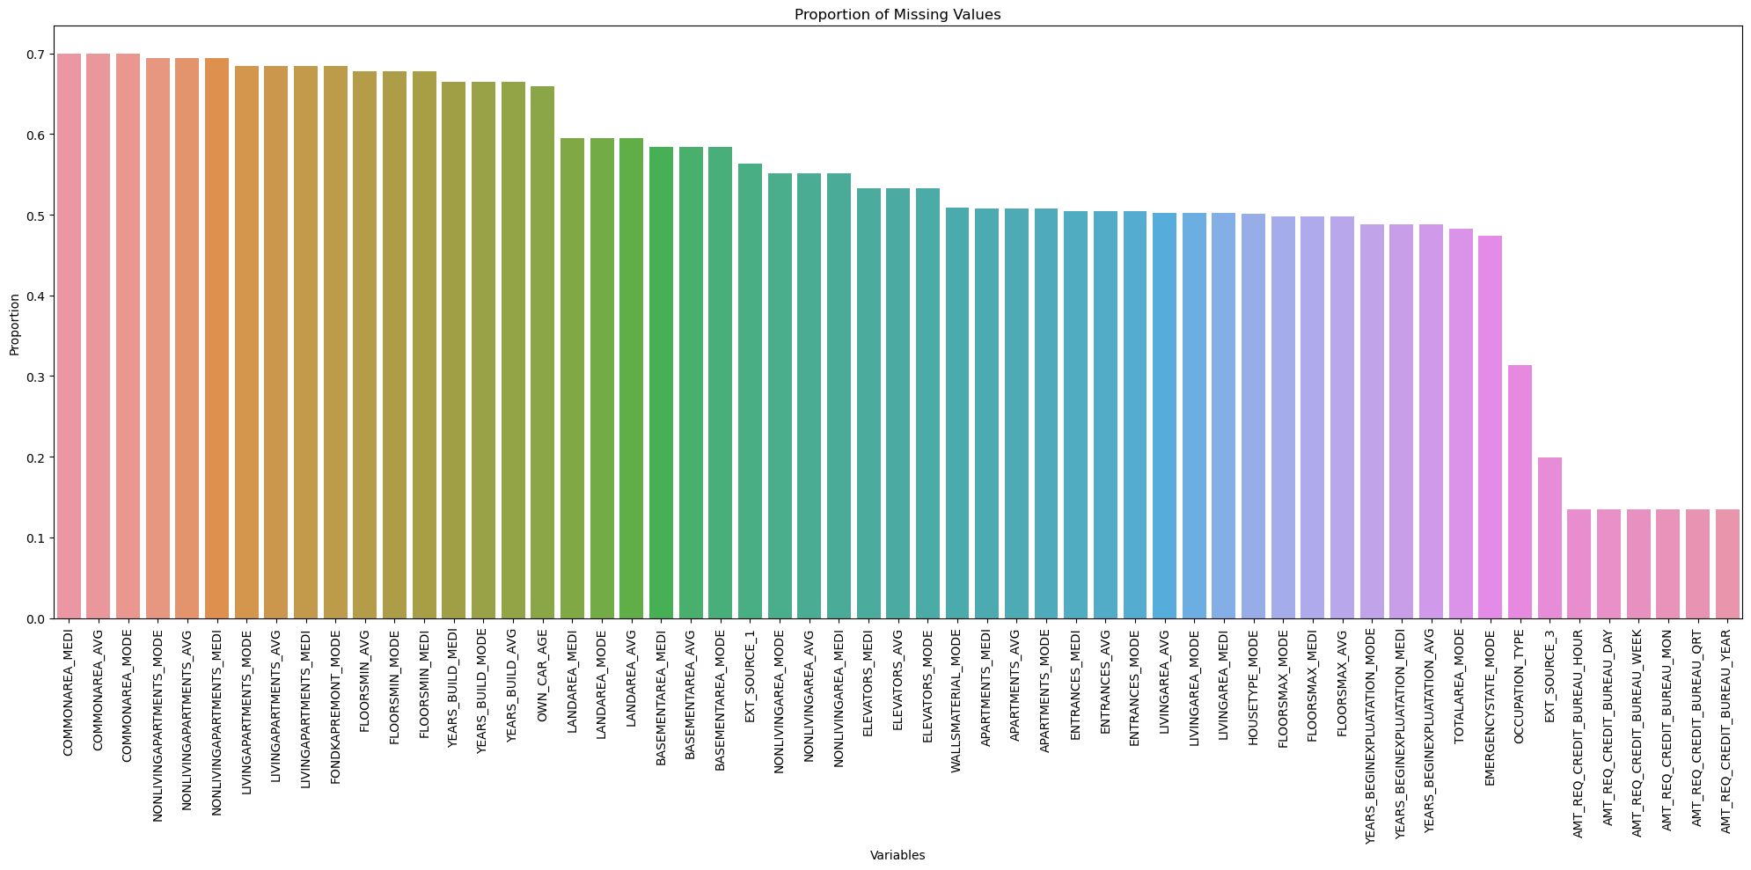

Slide 14
B
Detecting Data Outliers
Identify outliers in the loan application dataset.

Slide 15
Detecting Data Outliers
First, I Selected numerical columns for the analysis of Outliers.
numerical_columns = application_data.select_dtypes(include=[np.number]).columns
We know that outliers represent data points that deviate significantly from the bulk of the data due to factors such as measurement inaccuracies and errors during data input.
I used following steps to calculate Outliers
Step 1: Calculate Inter Quartile Range (IQR) of the data.
q1 = np.percentile(application_data[i], 25)
q3 = np.percentile(application_data[i], 75)
iqr = q3 - q1
Step 2: Define lower and upper bounds for outliers using calculated IQR
lower_bound = q1 - 1.5 * iqr
upper_bound = q3 + 1.5 * iqr
Step 3: Using those find and store outliers in the dataset.
outliers = [x for x in application_data[i] if x < lower_bound or x > upper_bound]
dictoutlier[i] = outliers
Then, Plot the box plot with variable name as title and outliers marked with red colour dots

Slide 16
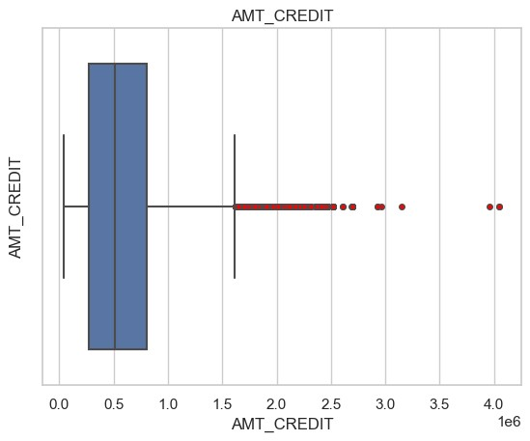
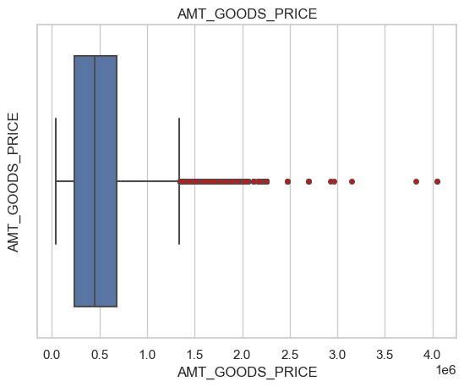
Box Plots
AMT_CREDIT, AMT_GOODS_PRICE and AMT_ANNUITY have almost the same box plot which shows that all three variables are very closely related.
As shown in the above Box Plots about 50% of data is inside the box part i.e. between 0.25-0.8.
Outliers are marked with red colour. Which have a value of more than 1.5

Slide 17
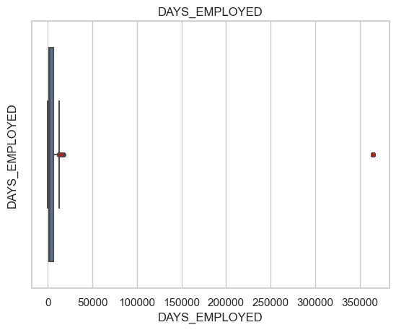
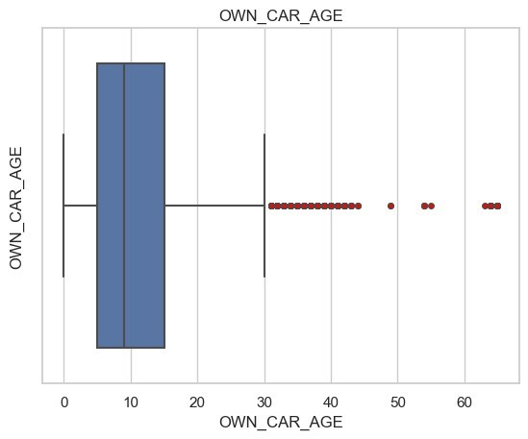
OWN_CAR_AGE variable has the age of the car owned by the applicants
As shown in the figure most cars have age in the range of 5-15.
Some cars between 30-60 are marked by red dots as outliers.
DAYS_EMPLOYED variable has a value of the total number of days an applicant is employed.
As shown in the figure most applicants have no of days employed between 0-15000 days.
Some applicants have about 370000 days employed which is clearly seen in the box plot.
Thus, they are outliers.

Slide 18
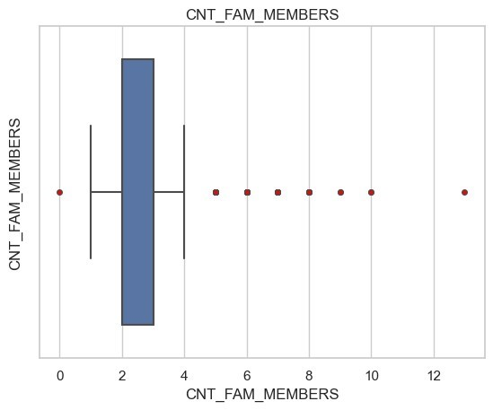
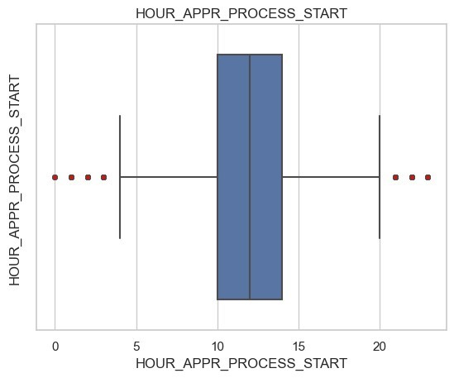
HOUR_APPR_PROCESS_START variable stores Approximately at what hour did the client apply for the loan?
As shown in the Box Plot most of the applicants applied between 10 am to 2 pm.
Applicants who apply between 0 am to 4 am & 8 pm to 12 am are outliers.
CNT_FAM_MEMBERS variable stores the total number of family members of the applicant.
It shows that 50% of applicants have 2 or 3 family members.
Some outliers which can be clearly seen in the box plot are 0,5,6,7,8,9,10 and 11

Slide 19
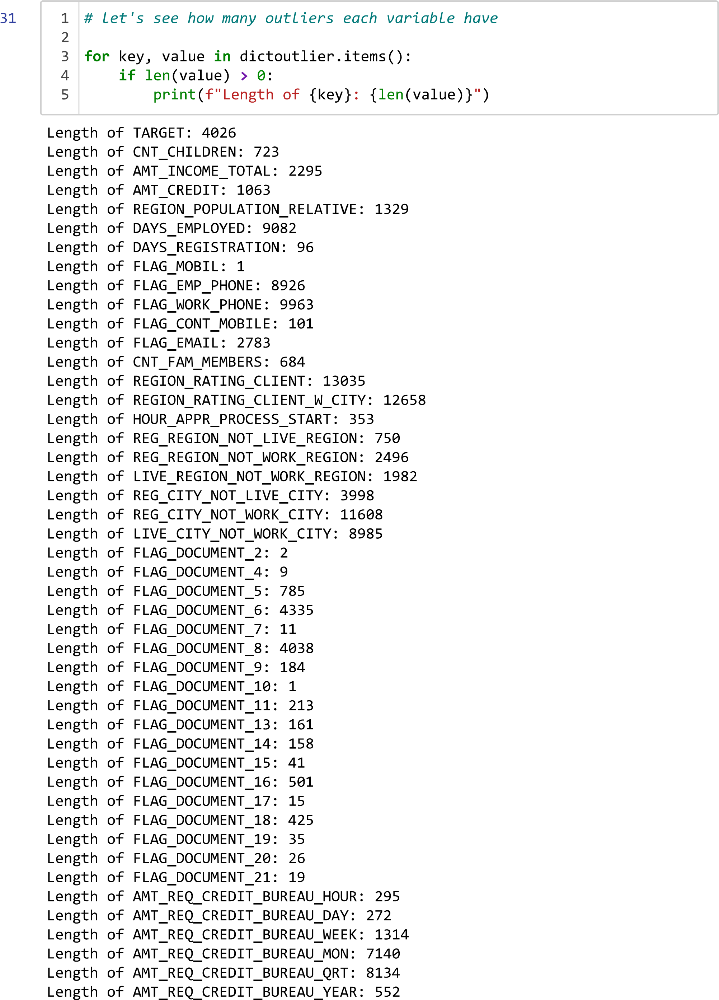
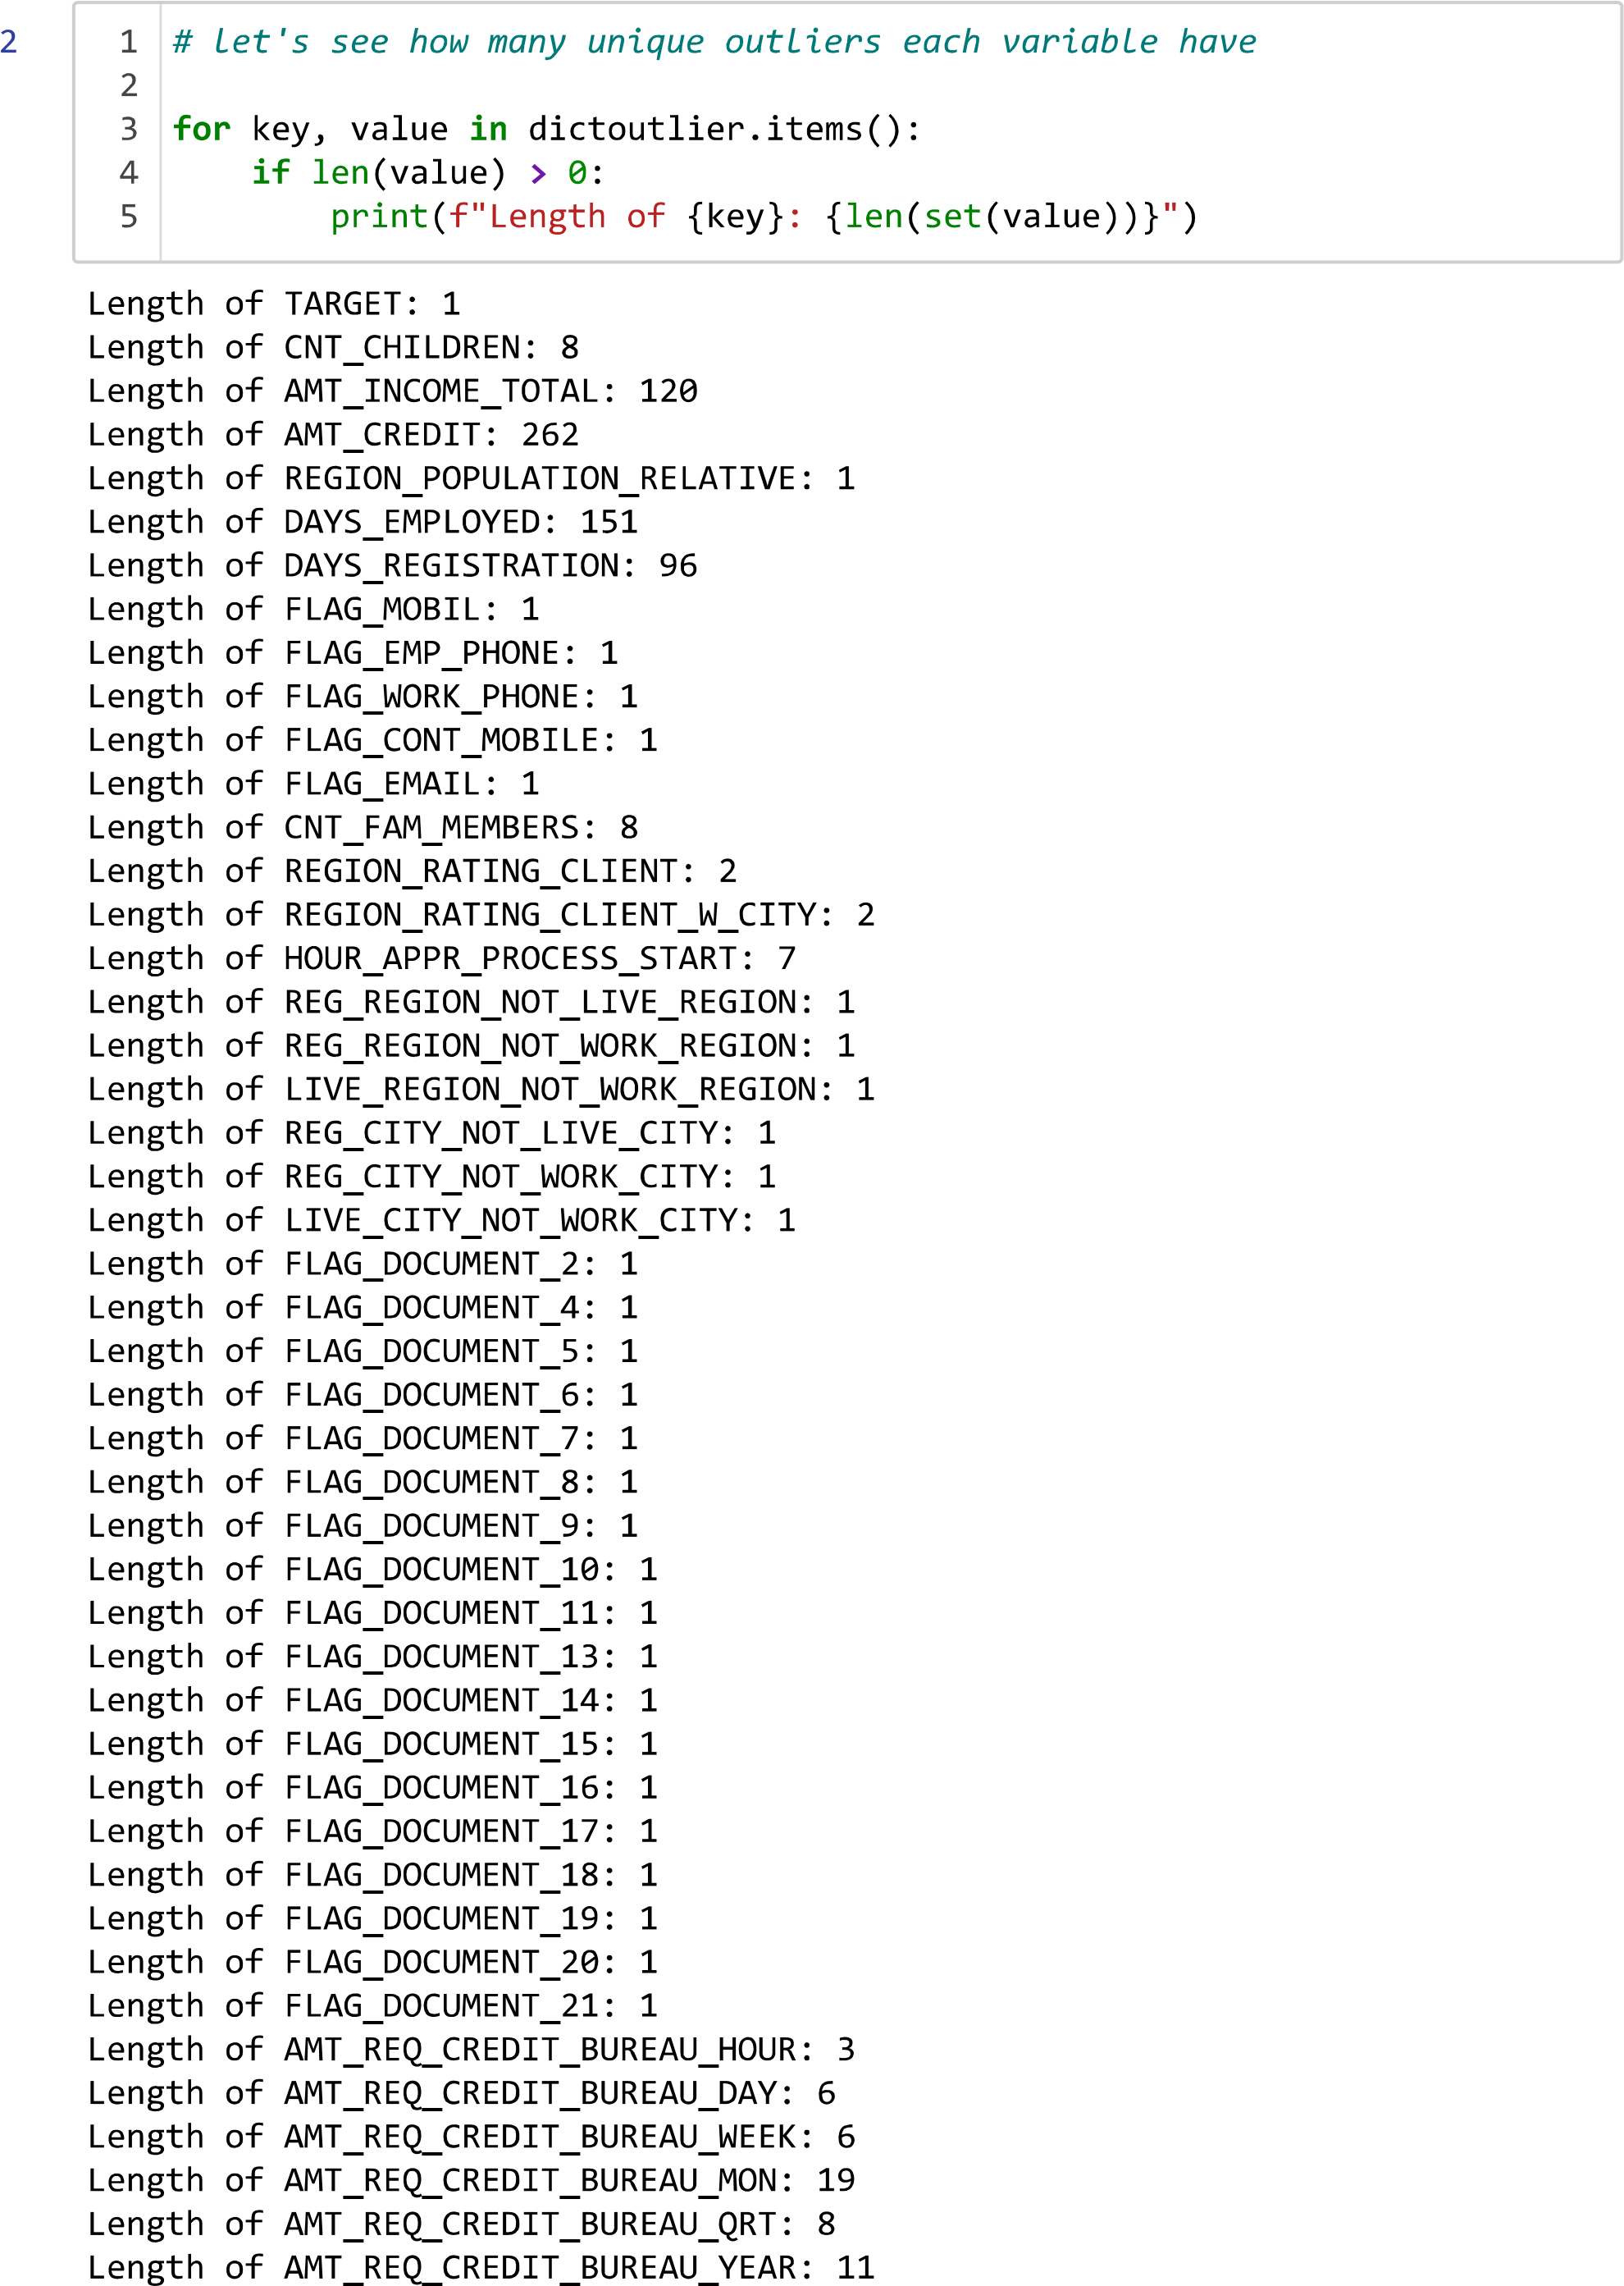
Total Outliers in each Variable
Count of Unique Outliers

Slide 20
C
Analyze Data Imbalance
Determine if there is a data imbalance in the loan application dataset.

Slide 21
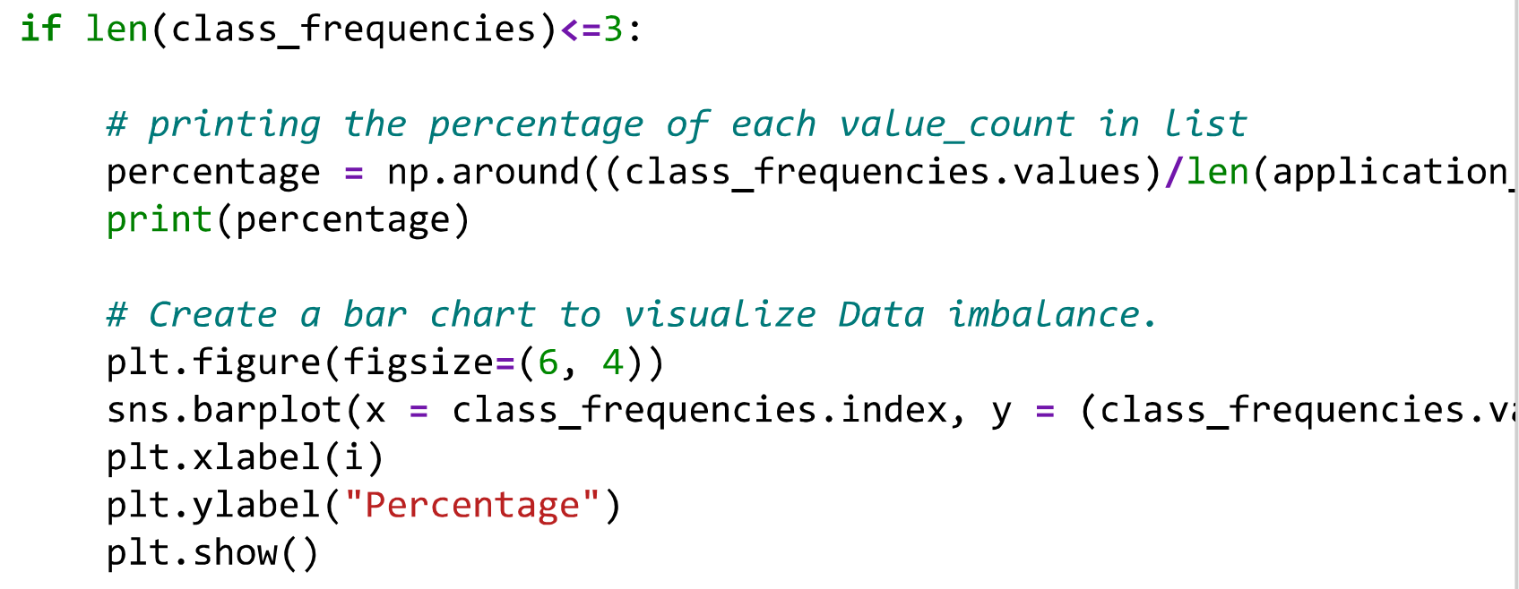
Analyze Data Imbalance
First, I have Calculated the class frequencies i.e. unique values in each variable and their total count.
class_frequencies = application_data[i].value_counts()
Then Created a bar chart to visualize Data imbalance.
Also, used the if condition to get only categorical variables.
In the same way also created a bar graph for Variables have class frequencies between 3-15.
Tables and bar_graphs are shown below.

Slide 22
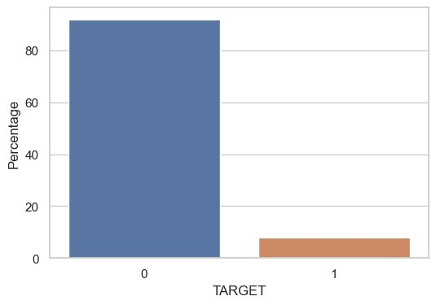
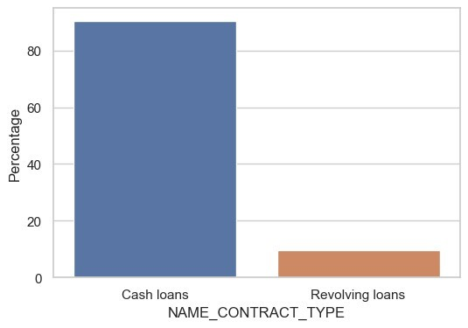
NAME_CONTRACT_TYPE has the 91% of loans of Cash Loans type.
Target variable shows us that 92% people have the value 1 i.e., clients with payment difficulties

Slide 23
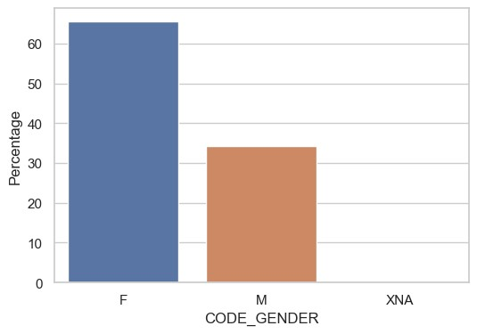
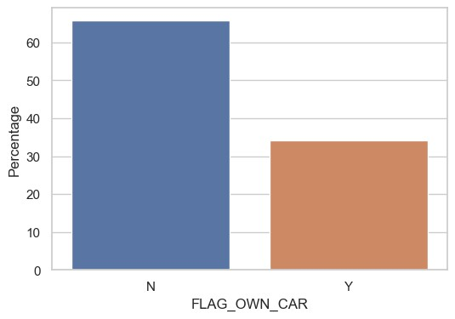
FLAG_OWN_CAR data imbalance shows us that 66% applicants don't own car.
CODE_GENDER data imbalance shows us that there are 66% female applicatns and 34% male applicants

Slide 24
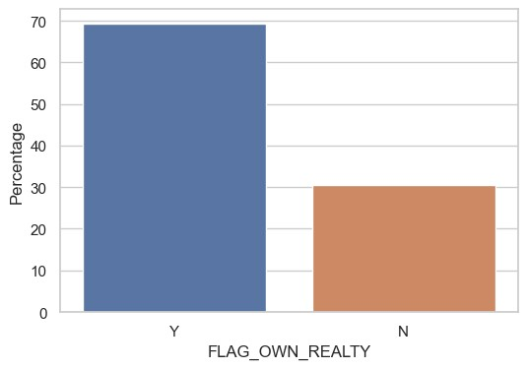
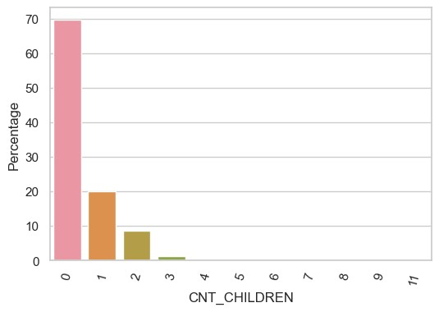
CNT_CHILDREN data imbalance shows us that 70% applicants don't have childrens.
FLAG_OWN_REALTY data imbalance shows us that 69% applicants own house.

Slide 25
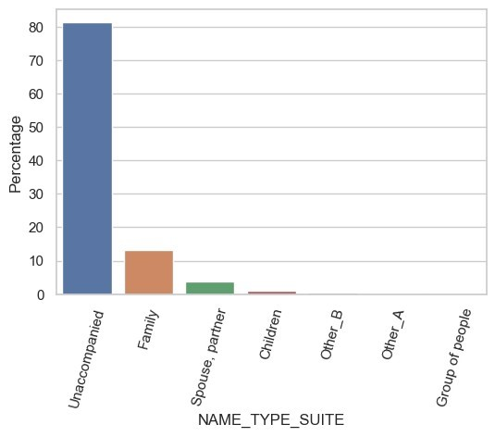
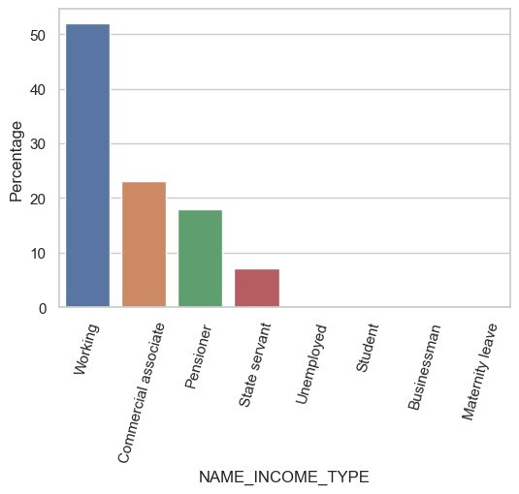
NAME_INCOME_TYPE data imbalance shows us that 52% applicants are working.
NAME_TYPE_SUITE data imbalance shows us that 81% of the applicants are unaccompined

Slide 26
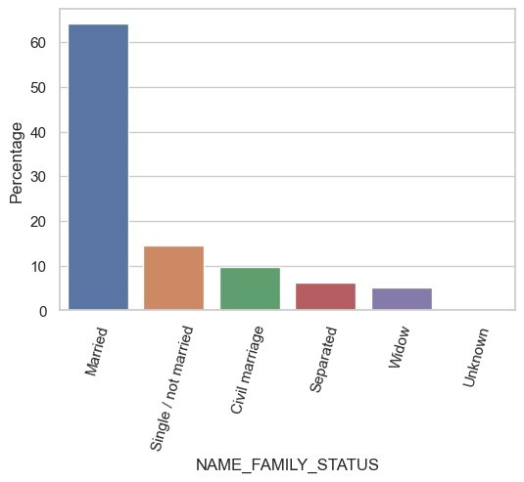
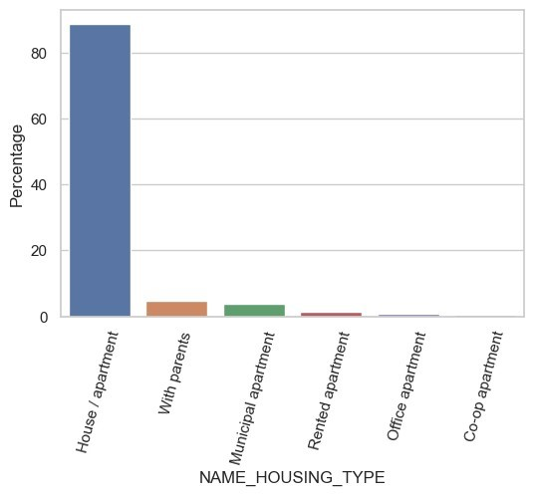
NAME_HOUSINGIN_TYPE data imbalance shows us that 52% applicants are live in House/Apartment.
NAME_FAMILY_STATUS data imbalance shows us that 64% of applicants are married.

Slide 27
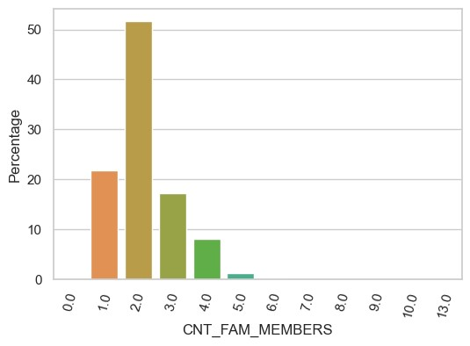
CNT_FAM_MEMBERES data imbalance shows us that 52% of applicants have 2 family members and 22%, 17% applicants have 1 & 3 family members respectively

Slide 28
D
Univariate, Segmented Univariate, and Bivariate Analysis

Slide 29
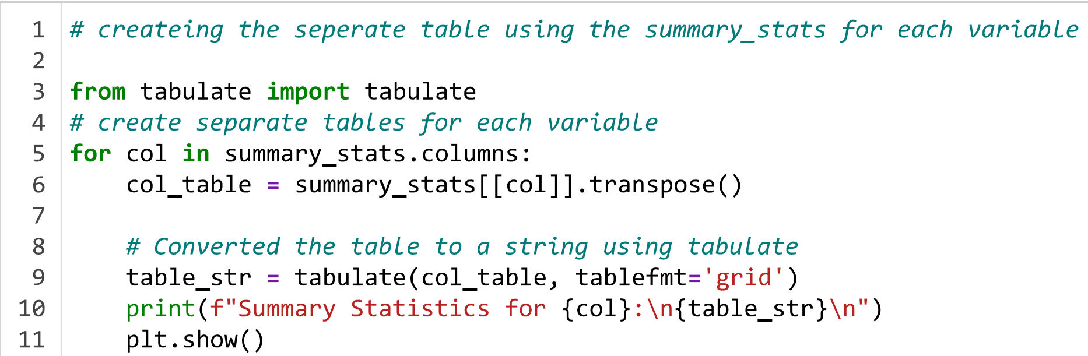
Univariate Analysis
We know Univariate analysis focuses on examining the distribution and summary statistics of individual variables.
summary_stats = application_data.describe()
Then by using the Tabulate library created the separate table for summary_stats of each variable.
Thus we get following result tables format for each variable.

Slide 30
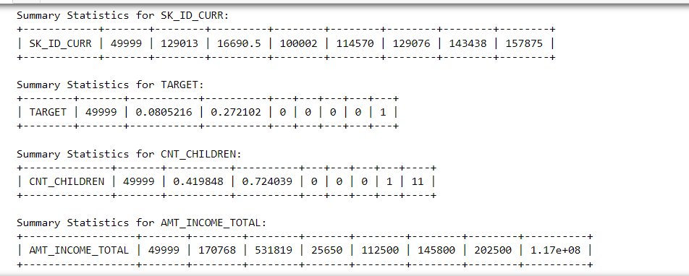
Result Tables
Here, the Summary Statistics for each Table are in the following order:
VariableName count mean std min 25% 50% 75% max

Slide 31
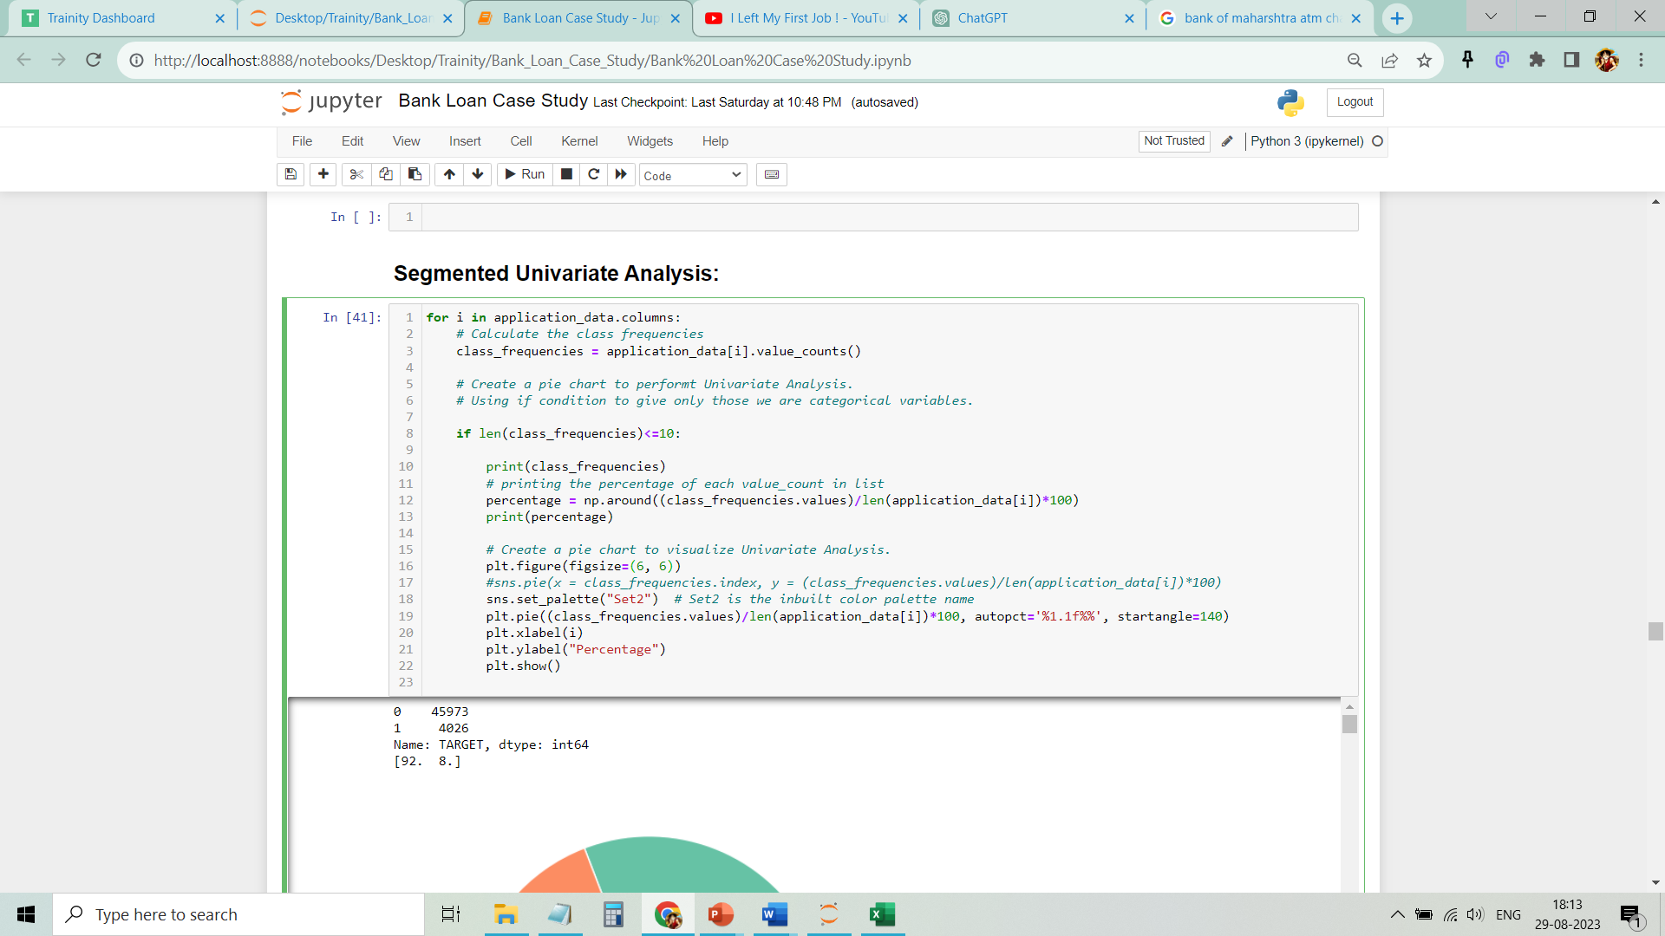
Segmented Univariate Analysis
We know Segmented univariate analysis involves examining individual variables separately within distinct subgroups to identify patterns or trends.
Thus, we first Calculated the class frequencies.
Then Created a pie chart to perform Univariate Analysis.
Used the following code/program to perform Segmented Univariate Analysis.

Slide 32
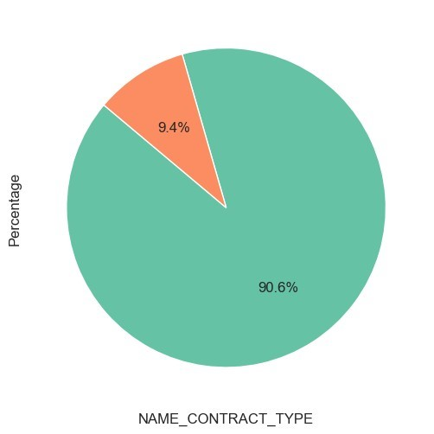
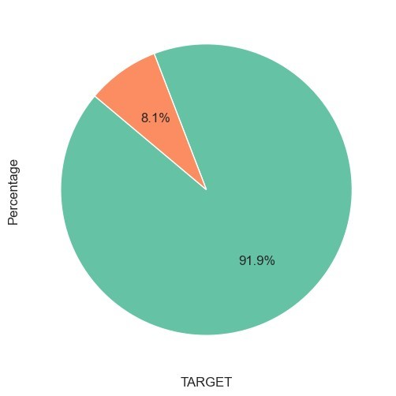
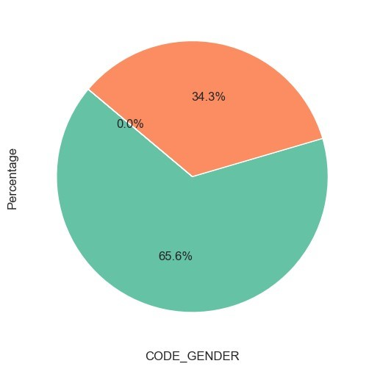
Cash loans 45276 Revolving loans 4723 Name: NAME_CONTRACT_TYPE, dtype: int64 [91. 9.]
0 45973 1 4026
Name: TARGET,
dtype: int64 [92. 8.]
F 32823 M 17174 XNA 2 Name: CODE_GENDER, dtype: int64 [66. 34. 0.]

Slide 33
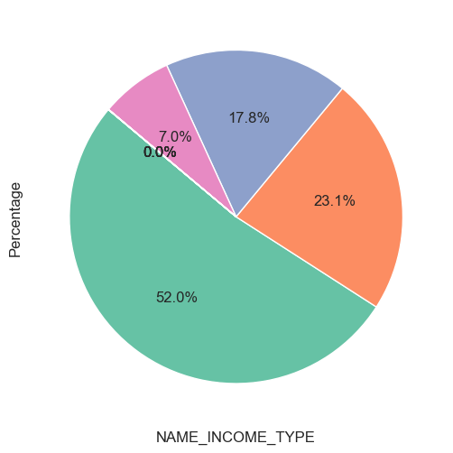
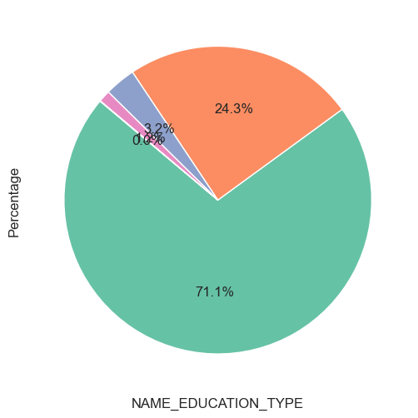
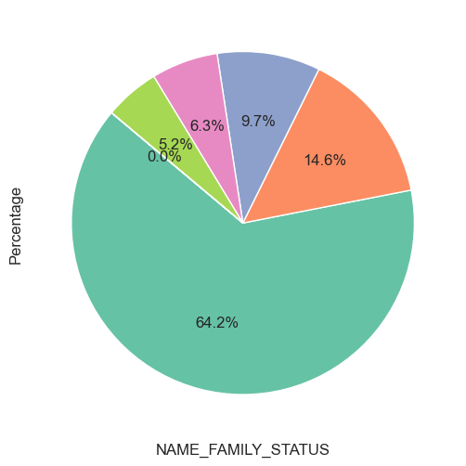
Working 26010
Commercial associate 11543 Pensioner 8920
State servant 3512
Unemployed 6
Student 5
Businessman 2
Maternity leave 1
Name: NAME_INCOME_TYPE, dtype: int64 [52. 23. 18. 7. 0. 0. 0. 0.]
secondary special 35572 Higher education 12167
Incomplete higher 1620
Lower secondary 620
Academic degree 20
Name: NAME_EDUCATION_TYPE,
dtype: int64 [71. 24. 3. 1. 0.]
Married 32094
Single / not married 7306 Civil marriage 4859
Separated 3142
Widow 2597
Unknown 1 Name: NAME_FAMILY_STATUS, dtype: int64 [64. 15. 10. 6. 5. 0.]

Slide 34
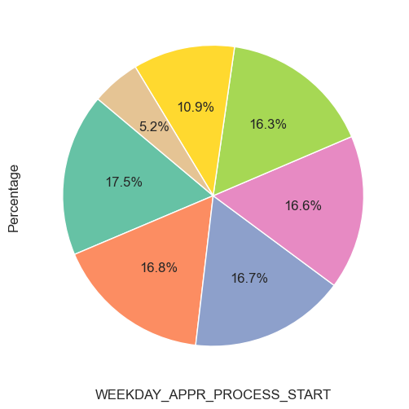
Inferences
-> target variable shows us that 92% people have the value 1 i.e. clients with payment difficulties
-> NAME_CONTRACT_TYPE has the 91% of loans of Cash Loans type.
-> CODE_GENDER univariate analysis shows us that there are 66% female applicants and 34% male applicants
-> FLAG_OWN_CAR univariate analysis shows us that 66% of applicants don’t own a car.
-> FLAG_OWN_REALTY univariate analysis shows us that 69% of applicants own a house.
-> CNT_CHILDREN univariate analysis shows us that 70% of applicants don't have children.
-> NAME_TYPE_SUITE univariate analysis shows us that 81% of the applicants are unaccompanied
-> NAME_INCOME_TYPE univariate analysis shows us that 52% of applicants are working.
-> NAME_FAMILY_STATUS univariate analysis shows us that 64% of applicants are married.
-> NAME_HOUSINGIN_TYPE univariate analysis shows us that 52% of applicants live in Houses/Apartments.
-> CNT_FAM_MEMBERES univariate analysis shows us that 52% of applicants have 2 family members and 22%, and 17% of applicants have 1 & 3 family members respectively
TUESDAY 8741
MONDAY 8385
WEDNESDAY 8355
FRIDAY 8286
THURSDAY 8149
SATURDAY 5467
SUNDAY 2616
Name: WEEKDAY_APPR_PROCESS_START, dtype: int64 [17. 17. 17. 17. 16. 11. 5.]

Slide 35
Bivariate Analysis
We know Bivariate analysis involves analyzing the relationship between two variables to understand their mutual interactions and correlations.
We created pariplot between some variables using following code.
sns.pairplot(application_data[['AMT_GOODS_PRICE','AMT_INCOME_TOTAL','AMT_CREDIT','AMT_ANNUITY’]])
Inference of the pairplots
The variables AMT_GOODS_PRICE, AMT_ANNUITY, and AMT_CREDIT show a good positive correlation, which is expected due to the higher cost of goods leading to larger loan amounts and subsequent annuity payments.
Thus I get following result graphs of pairplots.

Slide 36
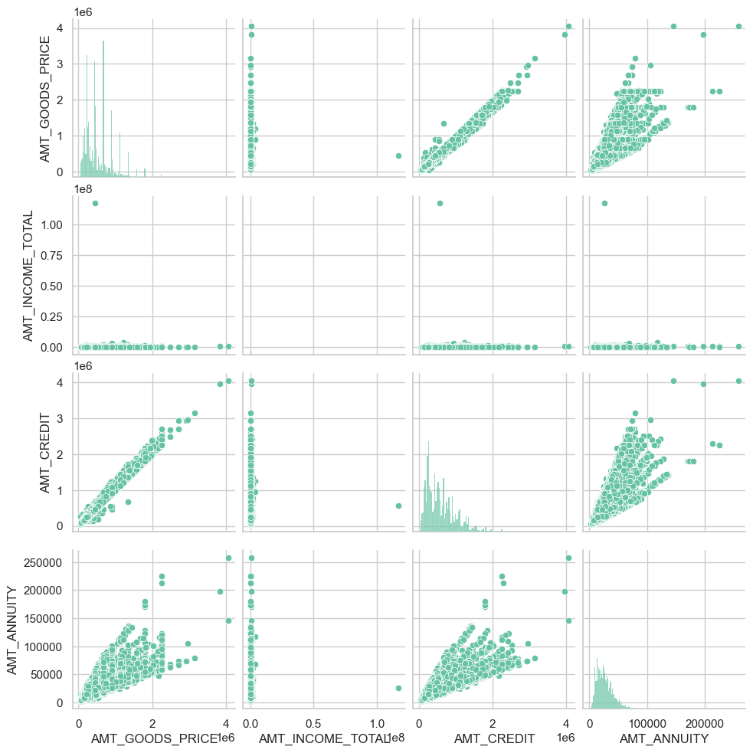

Slide 37
Bivariate Analysis
Then, I created a Boxplot to find Income Distribution by Gender and to find Credit Distribution by Gender.
I also created a Boxplot to find Credit Distribution by Income Type.
Inference of this Bivariate Analysis
Bivariate analysis between AMT_GOODS_PRICE and AMT_CREDIT through box plots segmented by CODE_GENDER shows that both male and female applicants tend to receive similar loan amounts.
Bivariate analysis of AMT_CREDIT through box plots segmented by NAME_INCOME_TYPE shows that Businessman get more Credit amount than that of other income types.

Slide 38
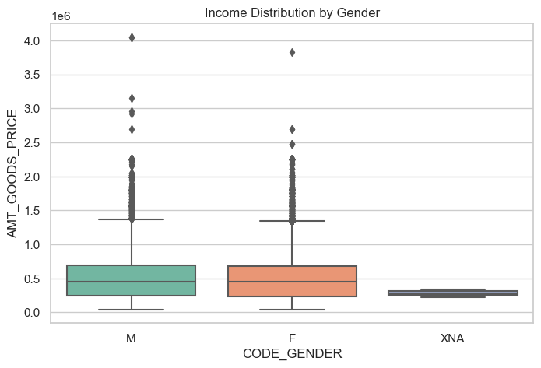
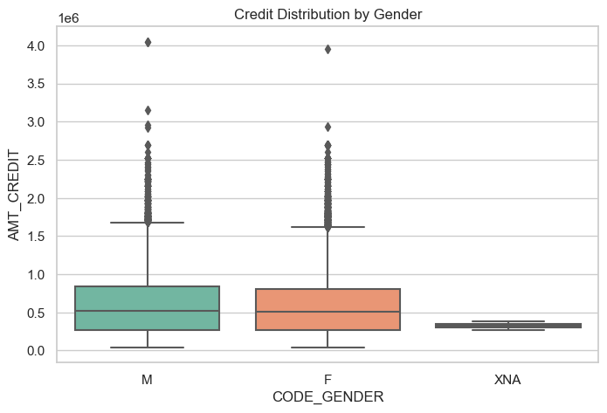

Slide 39
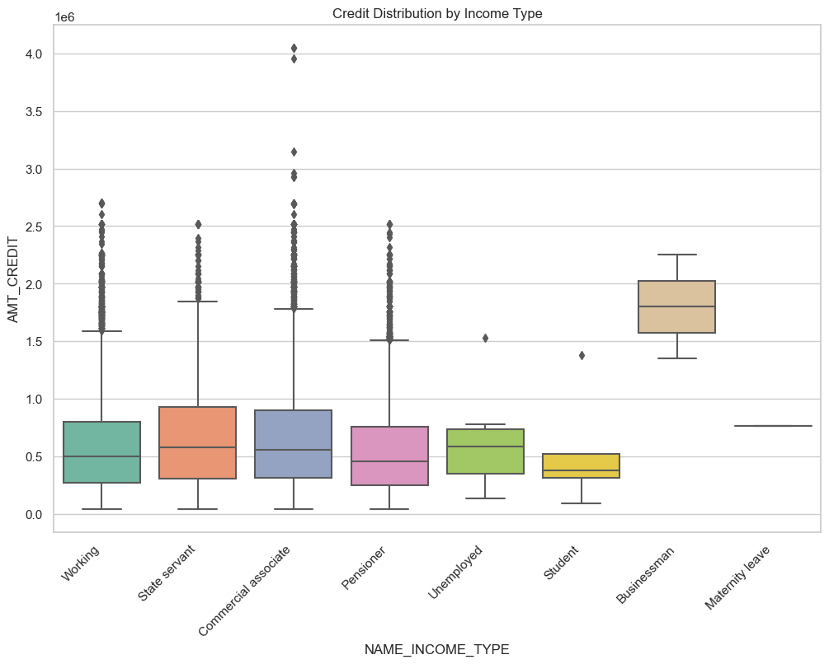

Slide 40
E
Top Correlations for Different Scenarios
Understanding the correlation between variables can provide insights into strong indicators of loan default.

Slide 41
Budget Analysis
Correlation is a statistical measure that indicates the degree and direction of a linear relationship between two variables.
Where values closer to +1 or -1 suggest strong correlation, while values closer to 0 suggest weak or no correlation.
Thus, to find the correlation between the numeric variables first I selected numeric variables and then by using the following code calculated the correlation of it with each other.
correlation = numerical_columns.corr()
Then by using the “sns.heatmap(correlation, square = True, vmax = 1, linewidths = 0.000001)” code/program I created the heatmap for the calculated correlations
Then I stored the upper triangle of the correlation matrix so that there are no same correlation values counted twice.
upper_triangle_values = correlation.where(np.triu(np.ones(correlation.shape), k=1).astype(bool))
Finally, by using these “upper_triangle_values” I find the top 5 highest correlations & find the top 5 lowest correlations.

Slide 42
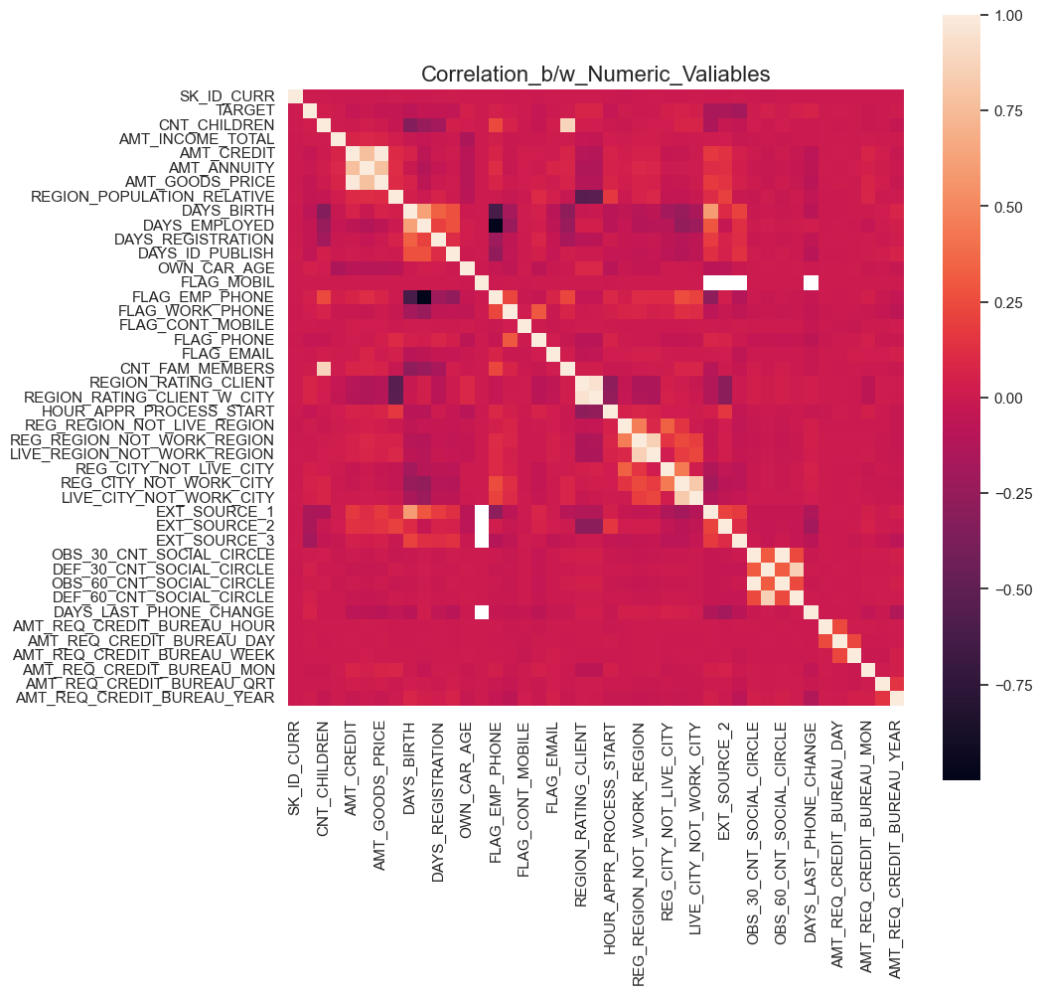

Slide 43
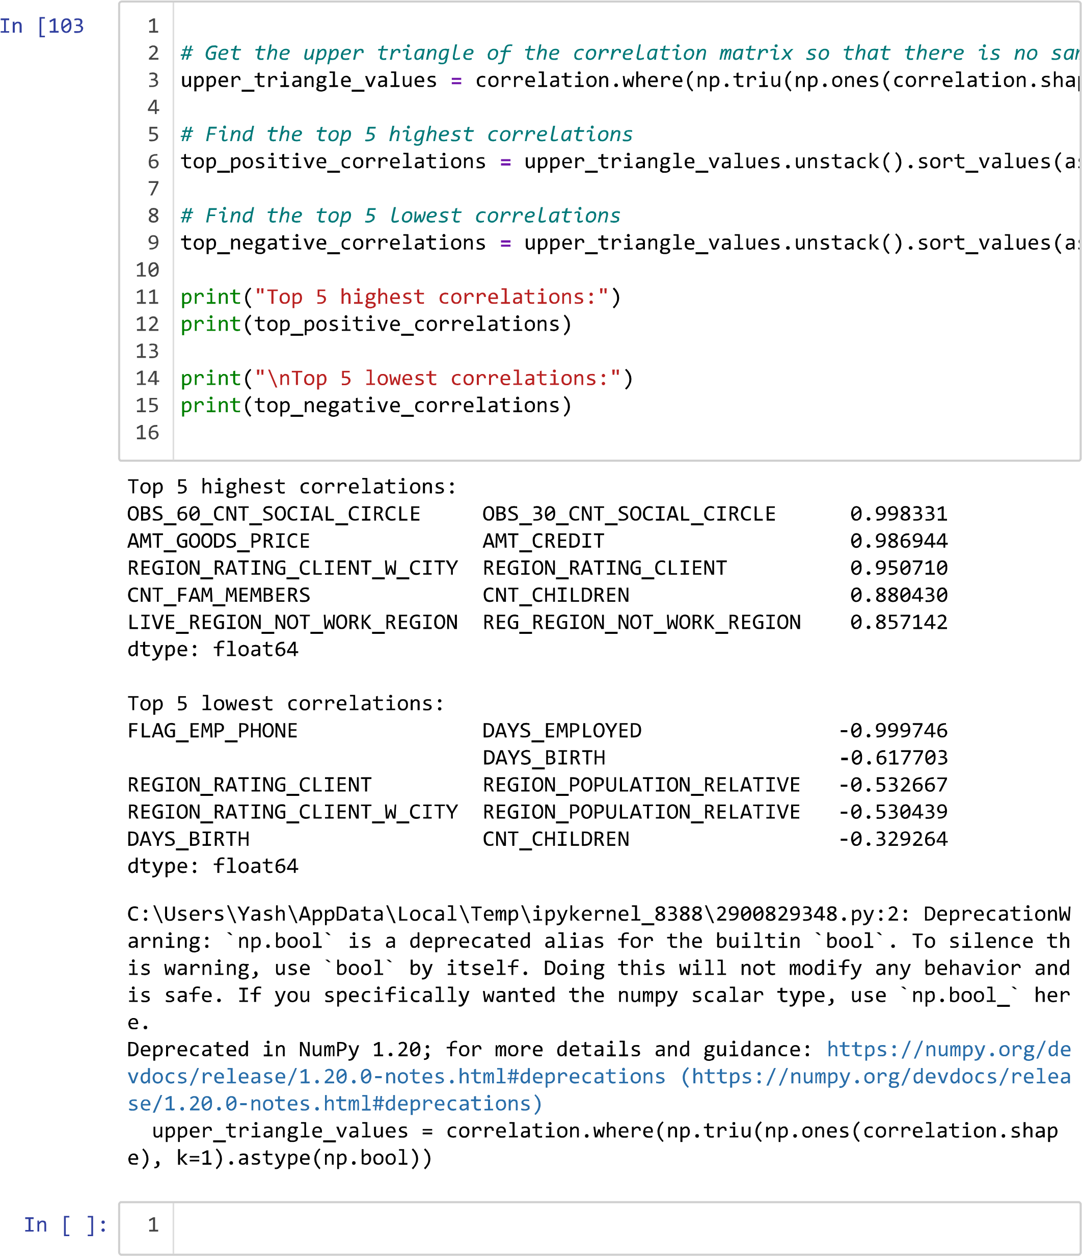

Slide 44
Conclusion

Slide 45
Thus, I have completed a Bank Loan Case Study.
Given key findings and all meaningful trends or patterns I have discovered.
I have learned to use Python Libraries (pandas, matplotlib, numpy and seaborn) to analyze the dataset.
I have learned to use Jupyter Notebook for Data Analysis.
All the respective Charts and their output are attached to this report.
GitHub Repository and drive links are given as follows.
GitHub Repository:- https://github.com/ShindeYash/Bank_Loan_Case_Study.git
Jupyter Notebook:- https://drive.google.com/file/d/12Cb27WusFFfHPV2SC-6nYsNTV156JsS2/view?usp=sharing
Drive Link:- https://drive.google.com/drive/folders/15rl6jAJjOlY_UGsrp9pXE084OLBboBXj?usp=sharing
Video Presentation:-https://www.loom.com/share/9c2f8b76127d4670803c25881c832743?sid=a81e1341-2feb-48da-a98d-0c62488c432e

Slide 46
Thanks!
Do you have any questions?
yashpradeepshinde@gmail.com
Yash Shinde

